Slide 1

HOW NOT TO PROGRAM YOUR GPUS. BASED ON MY DISSERTATION WORK “LOAD BALANCING ON THE GPU”
Muhammad Osama [mosama@ucdavis.edu]

Slide 2
THE 3 PERSPECTIVES
Programmability,
Performance, and
… everything else

Slide 3
THE 3 PERSPECTIVES
Programmability,
Performance, and
… everything else (Software Engineering)

Slide 4
MEMORY SYSTEM
HBM Memory
(80GB)
L2 Cache (40MB)
L1 Cache
(192K)
L1 Cache
(192K)
…
L1 Cache
(192K)
Reg
(256K)
Reg
(256K)
…
Reg
(256K)
Notes:
Memory system can only feed about 1/6th (6.3x) of what the execution resource can request (9750/1555).
Laws of physics dictate that random accesses sucks, and good memory patterns are everything.

Slide 5
COMPUTE HIERARCHY
Cooperative Thread Block
Cooperative Thread Block
Warp
Warp
Warp
Warp
…
…
…
…
Thread_{N}
int i = blockIdx.x * blockDim.x + threadIdx.x;
...
y[i] = a * x[i] + y[i];
Notes:
All threads (lots of threads at once) on the warp need to be working on adjacent data.
Warp execution model helps keep the execution units fed.
Hardware spreads out blocks as widely as possible to max memory request.

Slide 6
OCCUPANCY
Threads
Registers
Shared Memory
Notes:
Occupancy is the next best thing, with the goal is to fit as much blocks on an SM as possible, which means more threads running in parallel.

Slide 7
CONCURRENCY
Threads
Registers
Shared Memory
Notes:
And when that is not possible, we rely on concurrency to feed it different types of work so it can schedule things in and out, and pack things efficiently.

Slide 8
“WHY CUDA PROGRAMMING IS THE WAY IT IS?”
Stephen Jones, CUDA Architect (NVIDIA)
It’s all physics.
Memory system is everything.
Occupancy is the next big thing.
Concurrency is saving grace.
… and oversubscription is how we achieve it.
Notes:
Memory system can only feed about 1/6th (6.3x) of what the execution resource can request (9750/1555).
Laws of physics dictate that random accesses sucks, and good memory patterns are everything.
All threads (lots of threads at once) on the warp need to be working on adjacent data.
Warp execution model helps keep the execution units fed.
Hardware spreads out blocks as widely as possible to max memory request.
Occupancy is the next best thing, with the goal is to fit as much blocks on an SM as possible, which means more threads running in parallel.
And when that is not possible, we rely on concurrency to feed it different types of work so it can schedule things in and out, and pack things efficiently.

Slide 9
What does that look like? CUDA 101.

Slide 10
constexpr int N = 1<<20;
float* x; float* y;
cudaMalloc(&x, N * sizeof(float));
cudaMalloc(&y, N * sizeof(float));
cudaMemset(x, 1.0f, N * sizeof(float));
cudaMemset(y, 2.0f, N * sizeof(float));
constexpr int block_size = 128;
int grid_size = (N – block_size + 1) / block_size;
saxpy<<<grid_size, block_size>>>(N, 2.0f, x, y);
cudaFree(x); cudaFree(y);

Slide 11
constexpr int N = 1<<20;
float* x; float* y;
cudaMalloc(&x, N * sizeof(float));
cudaMalloc(&y, N * sizeof(float));
cudaMemset(x, 1.0f, N * sizeof(float));
cudaMemset(y, 2.0f, N * sizeof(float));
constexpr int block_size = 128;
int grid_size = (N – block_size + 1) / block_size;
saxpy<<<grid_size, block_size>>>(N, 2.0f, x, y);
cudaFree(x); cudaFree(y);

Slide 12
__global__ void saxpy(const int N, const float a, const float *x, float *y) {
int i = blockIdx.x * blockDim.x + threadIdx.x;
if (i < N)
y[i] = a * x[i] + y[i];
}

Slide 13
__global__ void saxpy(const int N, const float a, const float *x, float *y) {
int i = blockIdx.x * blockDim.x + threadIdx.x;
if (i < N)
y[i] = a * x[i] + y[i];
}

Slide 14
__global__ void saxpy(const int N, const float a, const float *x, float *y) {
int i = blockIdx.x * blockDim.x + threadIdx.x;
if (i < N)
y[i] = a * x[i] + y[i];
}

Slide 15
__global__ void saxpy(const int N, const float a, const float *x, float *y) {
int i = blockIdx.x * blockDim.x + threadIdx.x;
if (i < N)
y[i] = a * x[i] + y[i];
}

Slide 16
This is great!

Slide 17
This is great!
No. It’s not.

Slide 18
PROBLEMS WITH THIS APPROACH.
Things crash when the grid stride exceeds the device limit.
Errors/Typos in calculating the grid stride (for example, ceil.)
There is no threads reuse, things are being created and destroyed.
You cannot debug by making the problem simpler: 1 thread, 1 block.
Readability (sequential saxpy is not written like the kernel code.)
https://developer.nvidia.com/blog/cuda-pro-tip-write-flexible-kernels-grid-stride-loops/

Slide 19
constexpr int N = 1<<20;
float* x; float* y;
cudaMalloc(&x, N * sizeof(float));
cudaMalloc(&y, N * sizeof(float));
cudaMemset(x, 1.0f, N * sizeof(float));
cudaMemset(y, 2.0f, N * sizeof(float));
constexpr int block_size = 128;
int grid_size = (N – block_size + 1) / block_size;
saxpy<<<grid_size, block_size>>>(N, 2.0f, x, y);
cudaFree(x); cudaFree(y);
Exceeds device limit.

Slide 20
constexpr int N = 1<<20;
float* x; float* y;
cudaMalloc(&x, N * sizeof(float));
cudaMalloc(&y, N * sizeof(float));
cudaMemset(x, 1.0f, N * sizeof(float));
cudaMemset(y, 2.0f, N * sizeof(float));
constexpr int block_size = 128;
int grid_size = (N – block_size + 1) / block_size;
saxpy<<<grid_size, block_size>>>(N, 2.0f, x, y);
cudaFree(x); cudaFree(y);
Improper division.

Slide 21
constexpr int N = 1<<20;
float* x; float* y;
cudaMalloc(&x, N * sizeof(float));
cudaMalloc(&y, N * sizeof(float));
cudaMemset(x, 1.0f, N * sizeof(float));
cudaMemset(y, 2.0f, N * sizeof(float));
constexpr int block_size = 128;
int grid_size = ceil_div(N, block_size);
saxpy<<<grid_size, block_size>>>(N, 2.0f, x, y);
cudaFree(x); cudaFree(y);
Improper division.

Slide 22
constexpr int N = 1<<20;
float* x; float* y;
cudaMalloc(&x, N * sizeof(float));
cudaMalloc(&y, N * sizeof(float));
cudaMemset(x, 1.0f, N * sizeof(float));
cudaMemset(y, 2.0f, N * sizeof(float));
constexpr int block_size = 128;
int grid_size = ceil_div(N, block_size);
saxpy<<<grid_size, block_size>>>(N, 2.0f, x, y);
cudaFree(x); cudaFree(y);
Correctness dependent on grid size.

Slide 23
Correctness dependent on grid size.
constexpr int N = 1<<20;
float* x; float* y;
cudaMalloc(&x, N * sizeof(float));
cudaMalloc(&y, N * sizeof(float));
cudaMemset(x, 1.0f, N * sizeof(float));
cudaMemset(y, 2.0f, N * sizeof(float));
saxpy<<<1, 1>>>(N, 2.0f, x, y);
cudaFree(x); cudaFree(y);

Slide 24
WHAT THE GPU SEES.
e.g.
N = 4096 elements
Number of SMs = 4 (hypothetical GPU)

Slide 25
OCCUPANCY
100%
Wave₀
threads(128) saxpy
SM₀
threads(128) saxpy
SM₁
threads(128) saxpy
SM₂
threads(128) saxpy
SM₃

Slide 26
OCCUPANCY
100%
OCCUPANCY
100%
Wave₀
Wave₂
threads(128) saxpy
threads(128) saxpy
SM₀
threads(128) saxpy
threads(128) saxpy
SM₁
threads(128) saxpy
threads(128) saxpy
SM₂
threads(128) saxpy
threads(128) saxpy
SM₃

Slide 27
OCCUPANCY
100%
OCCUPANCY
100%
OCCUPANCY
50%
Wave₀
Wave₂
Wave₃
threads(128) saxpy
threads(128) saxpy
threads(128) saxpy
SM₀
threads(128) saxpy
threads(128) saxpy
threads(128) saxpy
SM₁
threads(128) saxpy
threads(128) saxpy
SM₂
threads(128) saxpy
threads(128) saxpy
SM₃

Slide 28
OCCUPANCY
100%
OCCUPANCY
100%
OCCUPANCY
50%
Wave₀
Wave₂
Wave₃
threads(128) saxpy
threads(128) saxpy
threads(128) saxpy
SM₀
threads(128) saxpy
threads(128) saxpy
threads(128) saxpy
SM₁
threads(128) saxpy
threads(128) saxpy
Unused resources!
SM₂
threads(128) saxpy
threads(128) saxpy
SM₃

Slide 29
CUDA 201.

Slide 30
__global__ void saxpy(const int N, const float a, const float *x, float *y) {
int i = blockIdx.x * blockDim.x + threadIdx.x;
if (i < N)
y[i] = a * x[i] + y[i];
}

Slide 31
__global__ void saxpy(const int N, const float a, const float *x, float *y) {
for (int i = blockIdx.x * blockDim.x + threadIdx.x;
i < N;
i += blockDim.x * gridDim.x) {
y[i] = a * x[i] + y[i];
}
}

Slide 32
__global__ void saxpy(const int N, const float a, const float *x, float *y) {
for (int i = blockIdx.x * blockDim.x + threadIdx.x;
i < N;
i += blockDim.x * gridDim.x) {
y[i] = a * x[i] + y[i];
}
}

Slide 33
__global__ void saxpy(const int N, const float a, const float *x, float *y) {
for (int i = blockIdx.x * blockDim.x + threadIdx.x;
i < N;
i += blockDim.x * gridDim.x) {
y[i] = a * x[i] + y[i];
}
}
THE “GRID STRIDE” LOOP
Notes:
Promotes maximum memory coalescing.
It decouples the launch from the kernel logic/computation.
Exhibits this “persistent” behavior.

Slide 34
__global__ void saxpy(const int N, const float a, const float *x, float *y) {
for (int i = blockIdx.x * blockDim.x + threadIdx.x;
i < N;
i += blockDim.x * gridDim.x) {
y[i] = a * x[i] + y[i];
}
}
THE “GRID STRIDE” LOOP
Thread 0
Grid Stride
Notes:
Promotes maximum memory coalescing.
It decouples the launch from the kernel logic/computation.
Exhibits this “persistent” behavior.

Slide 35
__global__ void saxpy(const int N, const float a, const float *x, float *y) {
for (int i = blockIdx.x * blockDim.x + threadIdx.x;
i < N;
i += blockDim.x * gridDim.x) {
y[i] = a * x[i] + y[i];
}
}
THE “GRID STRIDE” LOOP
Thread 0
Thread 0
Grid Stride
Notes:
Promotes maximum memory coalescing.
It decouples the launch from the kernel logic/computation.
Exhibits this “persistent” behavior.

Slide 36
...
constexpr int block_size = 128;
int grid_size = ceil_div(N, block_size);
saxpy<<<grid_size, block_size>>>(N, 2.0f, x, y);
...
“DATA PARALLEL” MODE
Notes:
DP:
Launch grid of g = (t) CTAs
(t * i total iterations) / (g CTAs) = i iterations per CTA
Split-K:
Assuming splitting-factor s, launch grid g = (t * s) CTAs
(t * i total iterations) / (g CTAs) = i / s iterations per CTA

Slide 37
...
constexpr int block_size = 128;
int grid_size = 1;
saxpy<<<grid_size, block_size>>>(N, 2.0f, x, y);
...
“DEBUG” MODE

Slide 38
...
constexpr int block_size = 128;
int grid_size = 2 * SMs;
saxpy<<<grid_size, block_size>>>(N, 2.0f, x, y);
...
“...” MODE

Slide 39
Wave₀
threads(384) saxpy
SM₀
threads(384) saxpy
SM₁
threads(256) saxpy
Unused resources!
SM₂
threads(256) saxpy
SM₃
Notes:
Except this. This is still not solved. Partially because saxpy is too simple of a problem to illustrate it.

Slide 40
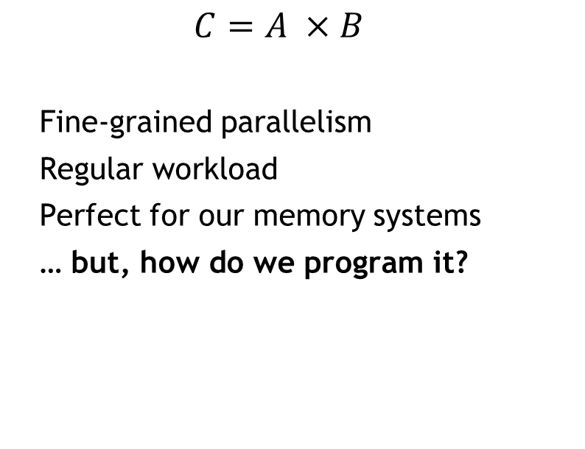
LET’S ILLUSTRATE USING A REAL PROBLEM.
General Matrix-Multiplication (GEMM)
$$C=A ×B$$
Fine-grained parallelism
Regular workload
Perfect for our memory systems
… but, how do we program it?
X
A
B
0
1
2
3
4
5
6
7
8

Slide 41
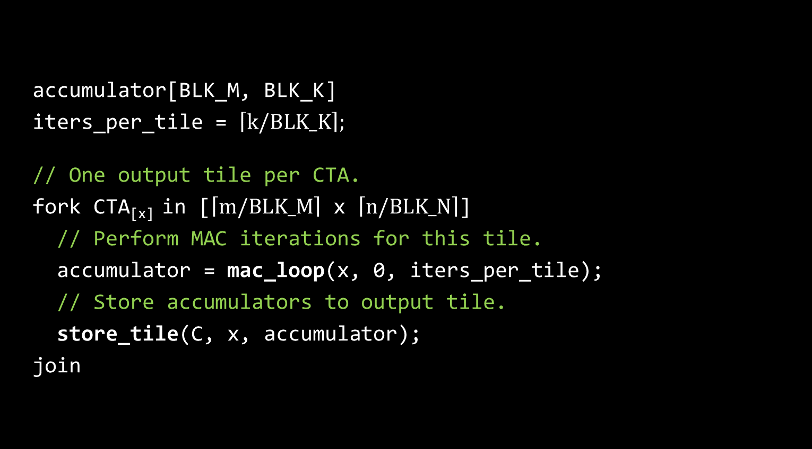
accumulator[BLK_M, BLK_K]
iters_per_tile = $\left\lceil k/BLK_K\right\rceil ;$ // One output tile per CTA.
fork CTA_{[x]} in [$\left\lceil m/BLK_M\right\rceil$ x $\left\lceil n/BLK_N\right\rceil$]
// Perform MAC iterations for this tile.
accumulator = mac_loop(x, 0, iters_per_tile);
// Store accumulators to output tile.
store_tile(C, x, accumulator);
join

Slide 42
X
A
B
0
1
2
3
4
5
6
7
8

Slide 43
X
A
B
0
1
2
3
4
5
6
7
8

Slide 44
X
A
B
0
1
2
3
4
5
6
7
8

Slide 45
X
A
B
0
1
2
3
4
5
6
7
8

Slide 46
X
A
B
0
1
2
3
4
5
6
7
8

Slide 47
OCCUPANCY
100%
Wave₀
0
SM₀
1
SM₁
2
SM₂
3
SM₃

Slide 48
OCCUPANCY
100%
OCCUPANCY
100%
Wave₀
Wave₂
0
4
SM₀
1
5
SM₁
2
6
SM₂
3
7
SM₃

Slide 49
OCCUPANCY
100%
OCCUPANCY
100%
OCCUPANCY
25%
Wave₀
Wave₂
Wave₃
0
4
8
SM₀
1
5
SM₁
2
6
SM₂
3
7
SM₃

Slide 50
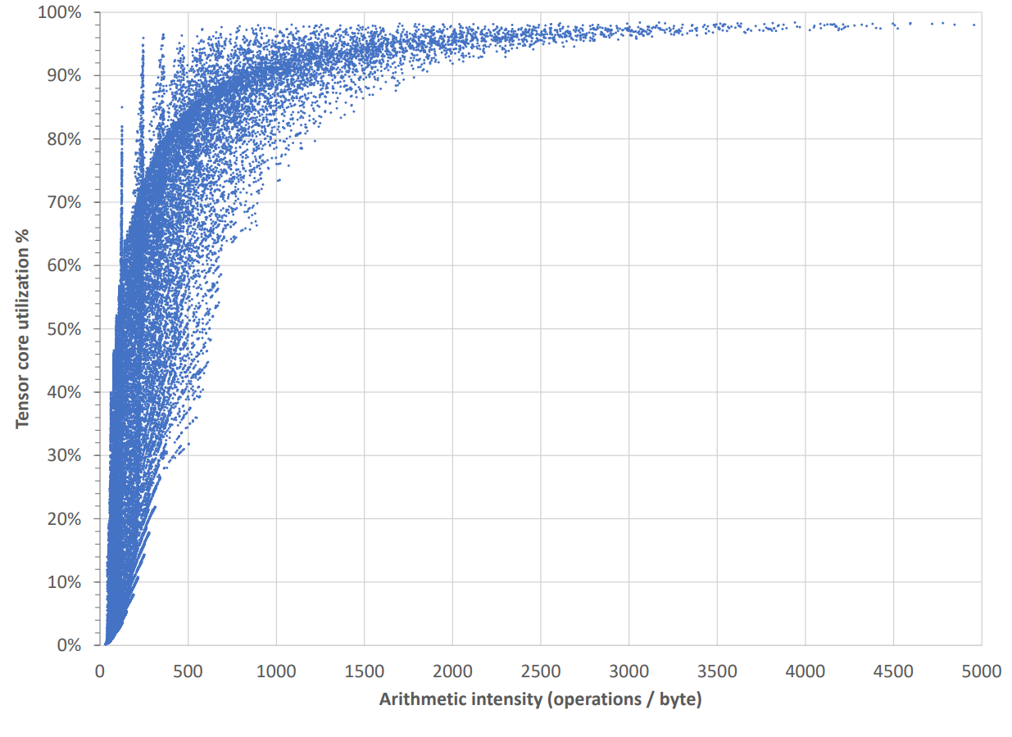
DATA-PARALLEL HGEMM.

Slide 51
OCCUPANCY
100%
OCCUPANCY
100%
OCCUPANCY
25%
75%
UTILIZATION CEIL
Wave₀
Wave₂
Wave₃
0
4
8
SM₀
1
5
Unused resources!
SM₁
2
6
SM₂
3
7
SM₃
Notes:
Millions of instructions are serialized over the k-loop!

Slide 52
OCCUPANCY
100%
OCCUPANCY
100%
OCCUPANCY
50%
90%
UTILIZATION CEIL
Wave₀
Wave₁
Wave₂
Wave₃
Wave₄
0
4
8
12
16
SM₀
1
5
9
13
17
SM₁
2
6
10
14
Unused resources!
SM₂
3
7
11
15
SM₃
Notes:
Maybe we make the tiles smaller…

Slide 53
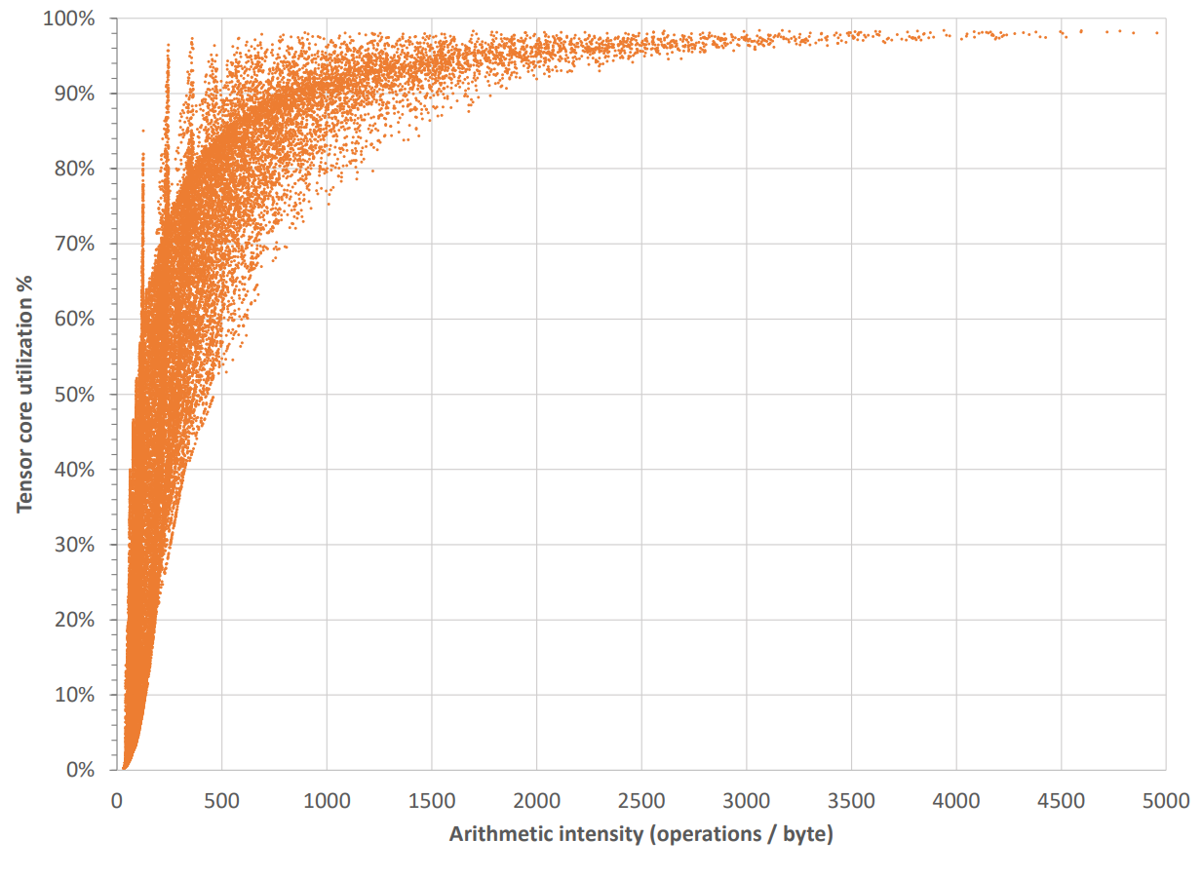
DATA-PARALLEL HGEMM W/ MORE TILE SIZES.

Slide 54
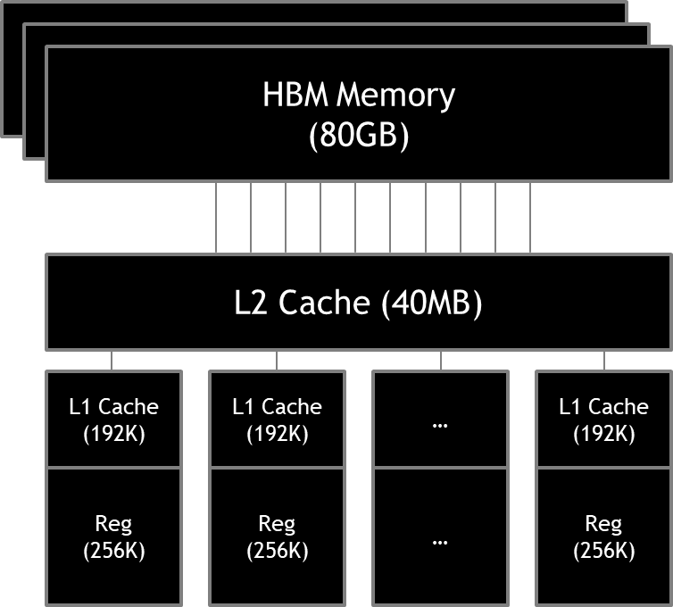
OCCUPANCY
100%
OCCUPANCY
100%
OCCUPANCY
50%
90%
UTILIZATION CEIL
Wave₀
Wave₁
Wave₂
Wave₃
Wave₄
0
4
8
12
16
SM₀
1
5
9
13
17
SM₁
2
6
10
14
Unused resources!
SM₂
3
7
11
15
SM₃
Notes:
Maybe we make the tiles smaller…

Slide 55
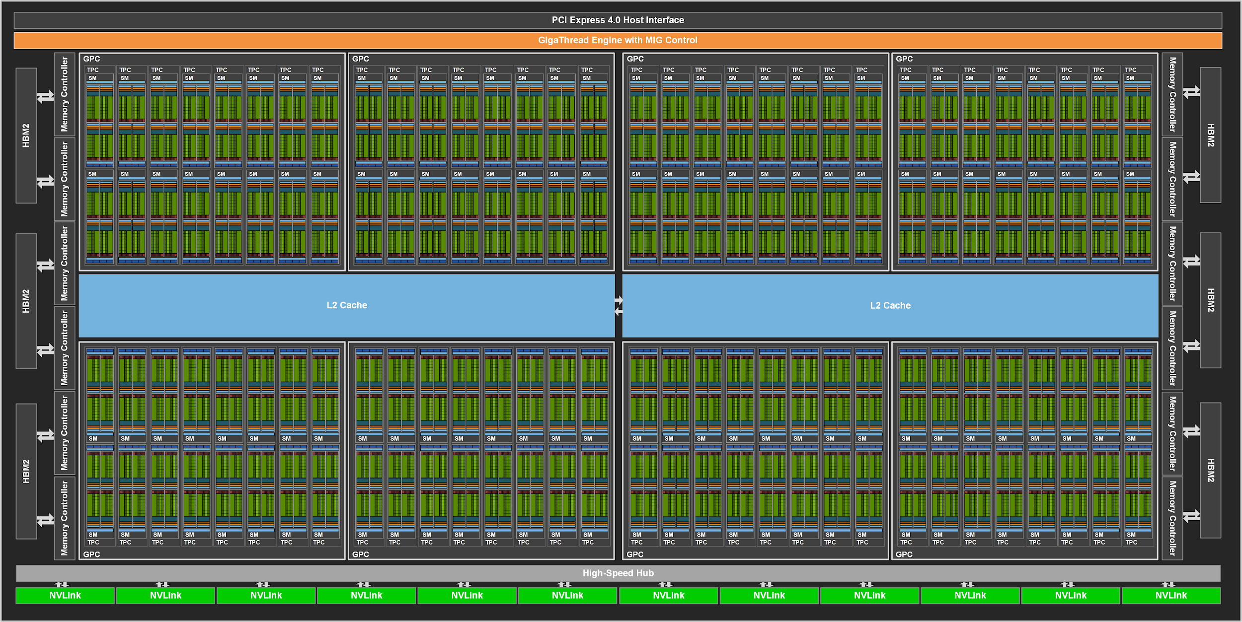
NVIDIA GA100 (128 SMs)
Notes:
The problem is worse on a real GPU, which now boasts over 100 SMs!
All needing to be fed at all times.

Slide 56
CUDA 201.5
“Work-centric approach” & Programmability
Consider scheduling as a first-class citizen when programming your GPUs.
Notes:
The amount of thought we put in optimizing our compute, we should put equally (if not more) thought in how that computation gets scheduled.

Slide 57
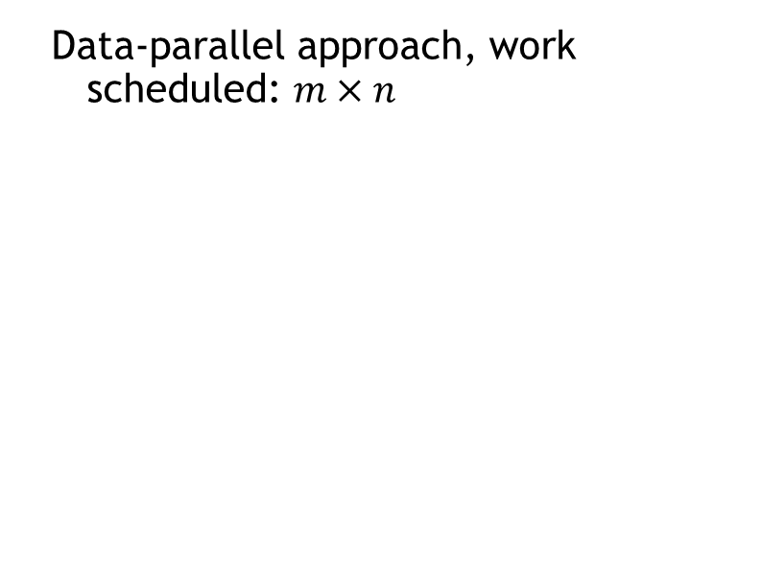
THE WORK-CENTRIC GEMM.
m
Data-parallel approach, work scheduled: $m×n$
X
A
B
0
1
2
3
4
5
n
6
7
8
Notes:
Anyone who has ever built a roofline model of GEMM would recognize that the total work that you have to do is not dependent only on m and n.

Slide 58
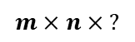
THE WORK-CENTRIC GEMM.
0
1
2
3
4
5
6
7
8
$$m×n× ?$$
Notes:
Anyone who has ever built a roofline model of GEMM would recognize that the total work that you have to do is not dependent only on m and n.

Slide 59
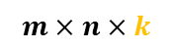
THE WORK-CENTRIC GEMM.
0
1
2
3
4
5
6
7
8
$$m×n×k$$
Main-Loop Iterations
Notes:
Anyone who has ever built a roofline model of GEMM would recognize that the total work that you have to do is not dependent only on m and n.

Slide 60

The Work-Centric GEMM.
Main-Loop Iterations
0
1
2
3
4
5
6
7
8
$$m×n×k$$
SM₀
SM₁
SM₂
SM₃
Notes:
Assuming p SMs, launch a constant number** of CTAs per SM
Give each CTA an even-share of the aggregate main-loop iterations
“Fixup” phase accumulates the “carry-out” partial-sums from each CTA
E.g.: 36 iterations are scheduled across four 128x128 CTAs. (Fixup finishes 3 tiles whose iterations span multiple CTAs.)

Slide 61
OCCUPANCY
100%
Wave₀
2
0
1
→ fixup
SM₀
fixup →
2
3
→ fixup
4
SM₁
fixup →
→ fixup
4
5
6
SM₂
fixup →
6
7
8
SM₃

Slide 62
__global__ gemm(...) {
// The Stream-K work-processing loop
while (cta_itr < cta_last_itr) {
...
// The standard tile-based GEMM main loop
accum = gemm_tile(tile_id, cta_itr - tile_first_itr, tile_stop_itr - tile_first_itr);
if (!started_tile && !finished_tile) {
// Carry-out partial sums
} else {
if (started_tile && !finished_tile) {
// Carry-in sets of partial sums
}
// Produce final output tile
eplilogue(accum, tile_id);
}
}
}

Slide 63
__global__ gemm(...) {
// The Stream-K work-processing loop
while (cta_itr < cta_last_itr) {
...
// The standard tile-based GEMM main loop
accum = gemm_tile(tile_id, cta_itr - tile_first_itr, tile_stop_itr - tile_first_itr);
if (!started_tile && !finished_tile) {
// Carry-out partial sums
} else {
if (started_tile && !finished_tile) {
// Carry-in sets of partial sums
}
// Produce final output tile
eplilogue(accum, tile_id);
}
}
}

Slide 64
...
constexpr int block_size = 128;
int grid_size = 1;
gemm<<<grid_size, block_size>>>(...);
...
“DEBUG” MODE

Slide 65
...
constexpr int block_size = 128;
int grid_size = 2 * SMs;
gemm<<<grid_size, block_size>>>(...);
...
“100% UTILIZATION” MODE

Slide 66
...
constexpr int block_size = 128;
int grid_size = num_output_tiles;
gemm<<<grid_size, block_size>>>(...);
...
“DATA PARALLEL” MODE
Notes:
DP:
Launch grid of g = (t) CTAs
(t * i total iterations) / (g CTAs) = i iterations per CTA
Split-K:
Assuming splitting-factor s, launch grid g = (t * s) CTAs
(t * i total iterations) / (g CTAs) = i / s iterations per CTA

Slide 67
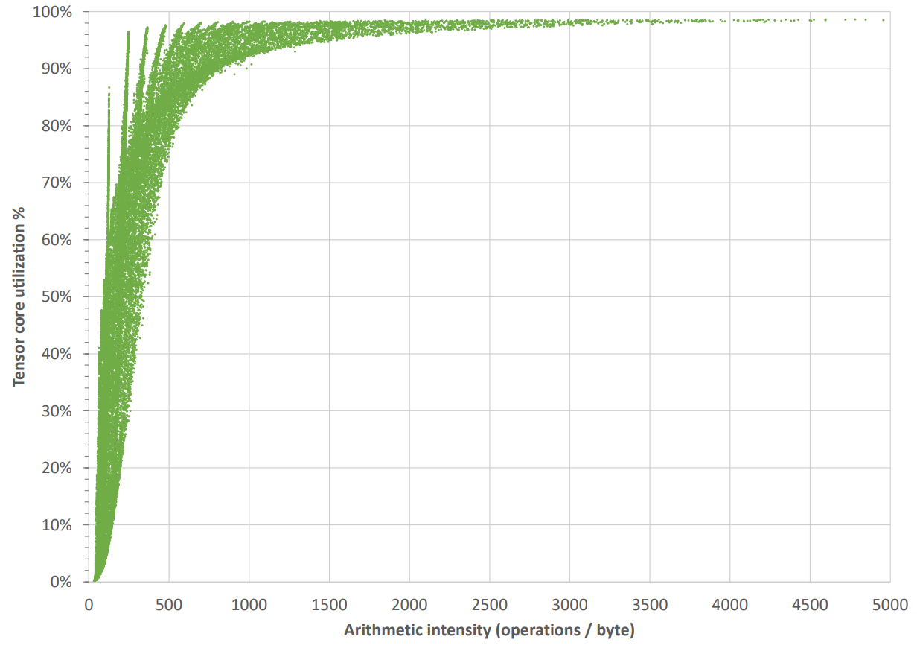
WORK-CENTRIC HGEMM.

Slide 68
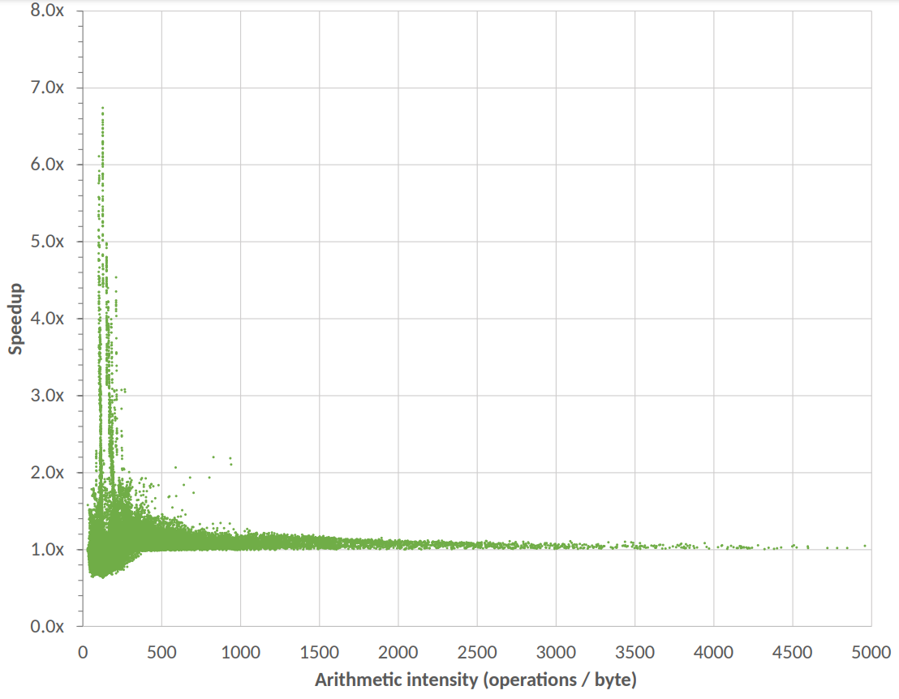
SPEED-UP COMPARED TO CUBLAS.

Slide 69
Generic Programming In CUDA/C++
(1) Lifting
Notes:
The first (and major) phase of the generic programming process is sometimes known as “lifting“ where we create generic algorithms through a process of successive generalization. That is, the process is
Study the concrete implementation of an algorithm
Lift away unnecessary requirements to produce a more abstract algorithm
Repeat the lifting process until we have obtained a generic algorithm that is as general as possible but that still instantiates to efficient concrete implementations
Catalog remaining requirements and organize them into concepts

Slide 70
__global__ void saxpy(const int N, const float a, const float *x, float *y) {
for (int i = blockIdx.x * blockDim.x + threadIdx.x;
i < N;
i += blockDim.x * gridDim.x) {
y[i] = a * x[i] + y[i];
}
}

Slide 71
__global__ void saxpy(const int N, const float a, const float *x, float *y) {
for (int i = blockIdx.x * blockDim.x + threadIdx.x;
i < N;
i += blockDim.x * gridDim.x) {
y[i] = a * x[i] + y[i];
}
}

Slide 72
__global__ void saxpy(const int N, const float a, const float *x, float *y) {
for (int i = blockIdx.x * blockDim.x + threadIdx.x;
i < N;
i += blockDim.x * gridDim.x) {
y[i] = a * x[i] + y[i];
}
}

Slide 73
__global__ void saxpy(const int N, const float a, const float *x, float *y) {
for (int i = blockIdx.x * blockDim.x + threadIdx.x;
i < N;
i += blockDim.x * gridDim.x) {
y[i] = a * x[i] + y[i];
}
}

Slide 74
__global__ void saxpy(const int N, const float a, const float *x, float *y) {
for (auto i : ranges::grid_stride_range(0, N)) {
y[i] = a * x[i] + y[i];
}
}

Slide 75
__global__ void saxpy(const int N, const float a, const float *x, float *y) {
for (auto i : ranges::grid_stride_range(0, N)) {
y[i] = a * x[i] + y[i];
}
}

Slide 76
__global__ void saxpy(const int N, const float a, const float *x, float *y) {
for (auto i : ranges::grid_stride_range(0, N)) {
y[i] = a * x[i] + y[i];
}
}

Slide 77
__global__ void saxpy(const int N, const float a, const float *x, float *y) {
for (auto i : ranges::grid_stride_range(0, N)) {
y[i] = a * x[i] + y[i];
}
}

Slide 78
__global__ void saxpy(const int N, const float a, const float *x, float *y) {
for (auto i : ranges::grid_stride_range(0, N)) {
y[i] = a * x[i] + y[i];
}
}

Slide 79
template <typename T>
__device__ __forceinline__ step_range_t<T>
grid_stride_range(T begin, T end) {
begin += blockIdx.x * blockDim.x + threadIdx.x;
return range(begin, end).step(blockDim.x * gridDim.x);
}

Slide 80
template <typename T>
__device__ __forceinline__ step_range_t<T>
grid_stride_range(T begin, T end) {
begin += blockIdx.x * blockDim.x + threadIdx.x;
return range(begin, end).step(blockDim.x * gridDim.x);
}

Slide 81
__global__ void saxpy(const int N, const float a, const float *x, float *y) {
for (auto i : ranges::grid_stride_range(0, N)) {
y[i] = a * x[i] + y[i];
}
}
Notes:
Study the concrete implementation of an algorithm
Lift away unnecessary requirements to produce a more abstract algorithm
Repeat the lifting process until we have obtained a generic algorithm that is as general as possible but that still instantiates to efficient concrete implementations
Catalog remaining requirements and organize them into concepts

Slide 82

/// Loading an integer from global into shared memory
__global__ void kernel(int *globalInput) {
__shared__ int x;
thread_block g = this_thread_block();
// Choose a leader in the thread block
if (g.thread_rank() == 0) {
// load from global into shared for
// all threads to work with
x = (*globalInput);
}
// After loading data into shared memory,
// you want to synchronize if all threads
// in your thread block need to see it
g.sync(); // equivalent to __syncthreads();
}

Slide 83
Generic Programming In CUDA/C++
(2) Specialization
Notes:
Duality to “lifting” is specialization. Once the algorithm is made generic, it is specialized through composition with concrete data type to realize a concrete implementation of a algorithm.

Slide 84
__global__
template<typename type_t, typename size_t>
void saxpy(const size_t N, const type_t a, const type_t *x, type_t *y) {
for (auto i : ranges::grid_stride_range(0, N)) {
y[i] = a * x[i] + y[i];
}
}
Notes:
Study the concrete implementation of an algorithm
Lift away unnecessary requirements to produce a more abstract algorithm
Repeat the lifting process until we have obtained a generic algorithm that is as general as possible but that still instantiates to efficient concrete implementations
Catalog remaining requirements and organize them into concepts

Slide 85
...
saxpy<float, int><<<grid_size, block_size>>>(N, 2.0f, x, y);
...
Notes:
You can envision more complicated specializations.
Maybe you want to run your GEMM kernel with all the different supported types.
And be able to profile the accuracy and speed-ups by using them.
Very powerful in practice to instantiate these specializations!

Slide 86
__global__ void saxpy(const int N, const float a, const float *x, float *y) {
for (auto i : ranges::grid_stride_range(0, N)) {
y[i] = a * x[i] + y[i];
}
}
Notes:
Study the concrete implementation of an algorithm
Lift away unnecessary requirements to produce a more abstract algorithm
Repeat the lifting process until we have obtained a generic algorithm that is as general as possible but that still instantiates to efficient concrete implementations
Catalog remaining requirements and organize them into concepts

Slide 87
Generic Programming In CUDA/C++
(3) Concepts
C++20
Notes:
Concepts consist of valid expressions and associated types, which define a family of allowable types admissible for composition with generic algorithms.

Slide 88
__global__
template<typename type_t, typename size_t>
void saxpy(const size_t N, const type_t a, const type_t *x, type_t *y) {
for (auto i : ranges::grid_stride_range(0, N)) {
y[i] = a * x[i] + y[i];
}
}
Valid?
Valid?
https://en.cppreference.com/w/cpp/concepts
Notes:
Concepts, theoretically would ensure what gets through is valid; and as a result the types being operated on produce the right/valid results.

Slide 89
WHY DOES IT MATTER?
Study existing works.
“Lift” away unnecessary requirements.
Repeat the process until we have found generic algorithm.
Express specializations (types, processes, etc.)
Catalog requirements (concepts.)
Generic programming is an instrumental process in developing abstractions.

Slide 90
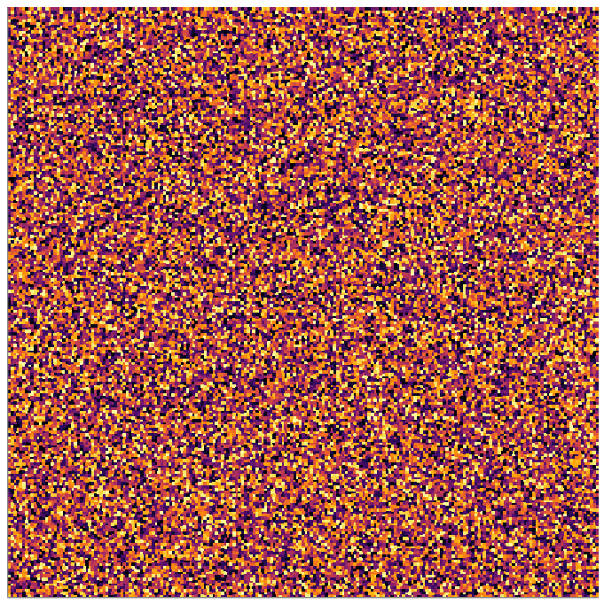
WHAT WE HAVE LOOKED AT SO FAR.
Regular problem.
Memory system’s heaven.
We solved the problem
(100% utilization)

Slide 91
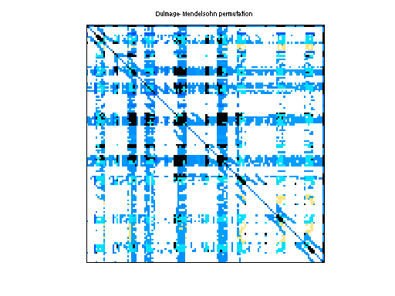
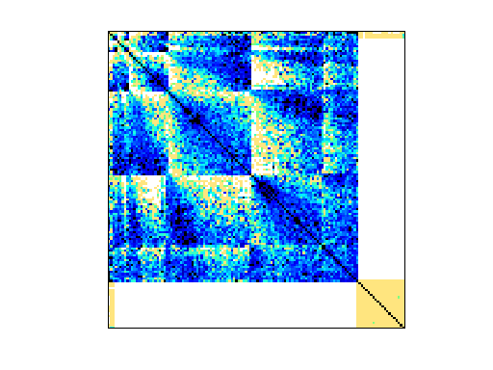
BUT WHAT IF… WORLD ISN’T ALL NICE.
ASIC_320K
Circuit Simulation
2,635,364 nonzeros
Thermomech_dK
Temperature & Deformation
2,846,228 nonzeros
Notes:
Both have approximately the same number of nonzeros
In fact, the ASIC which is circuit simulation has less nonzeros, or in other words, less work than Thermomech.
BUT their patterns vary a lot. In this case, ASIC has very varying row-lengths and Thermomech is in some sense quite structured.

Slide 92
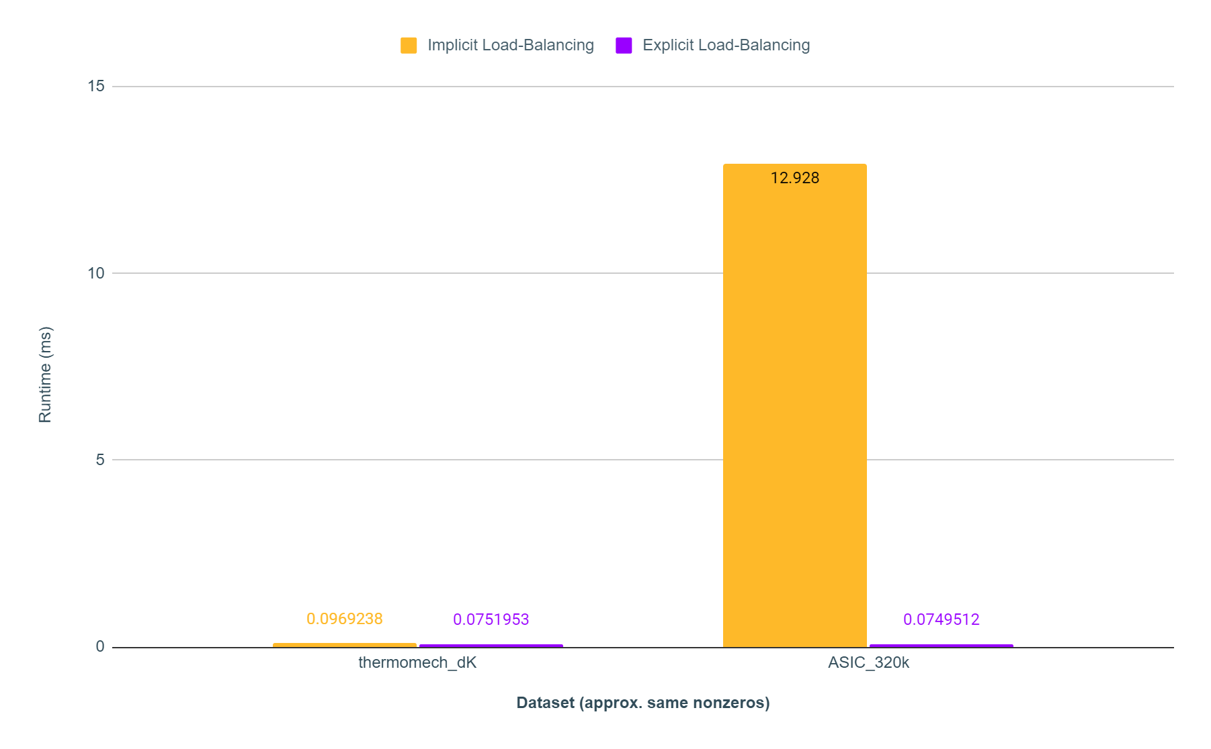
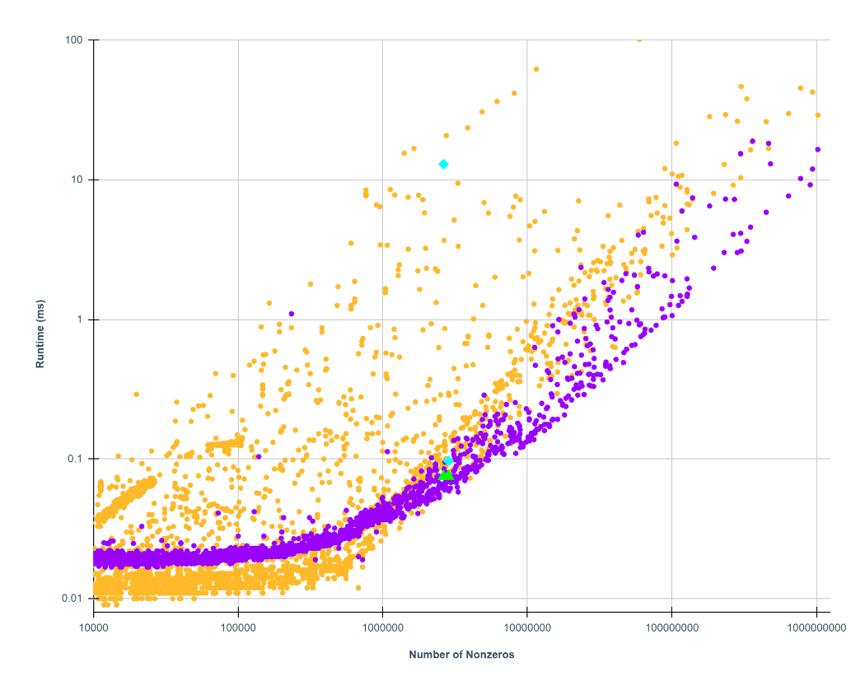

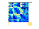
ASIC
ASIC
THERM

Slide 93
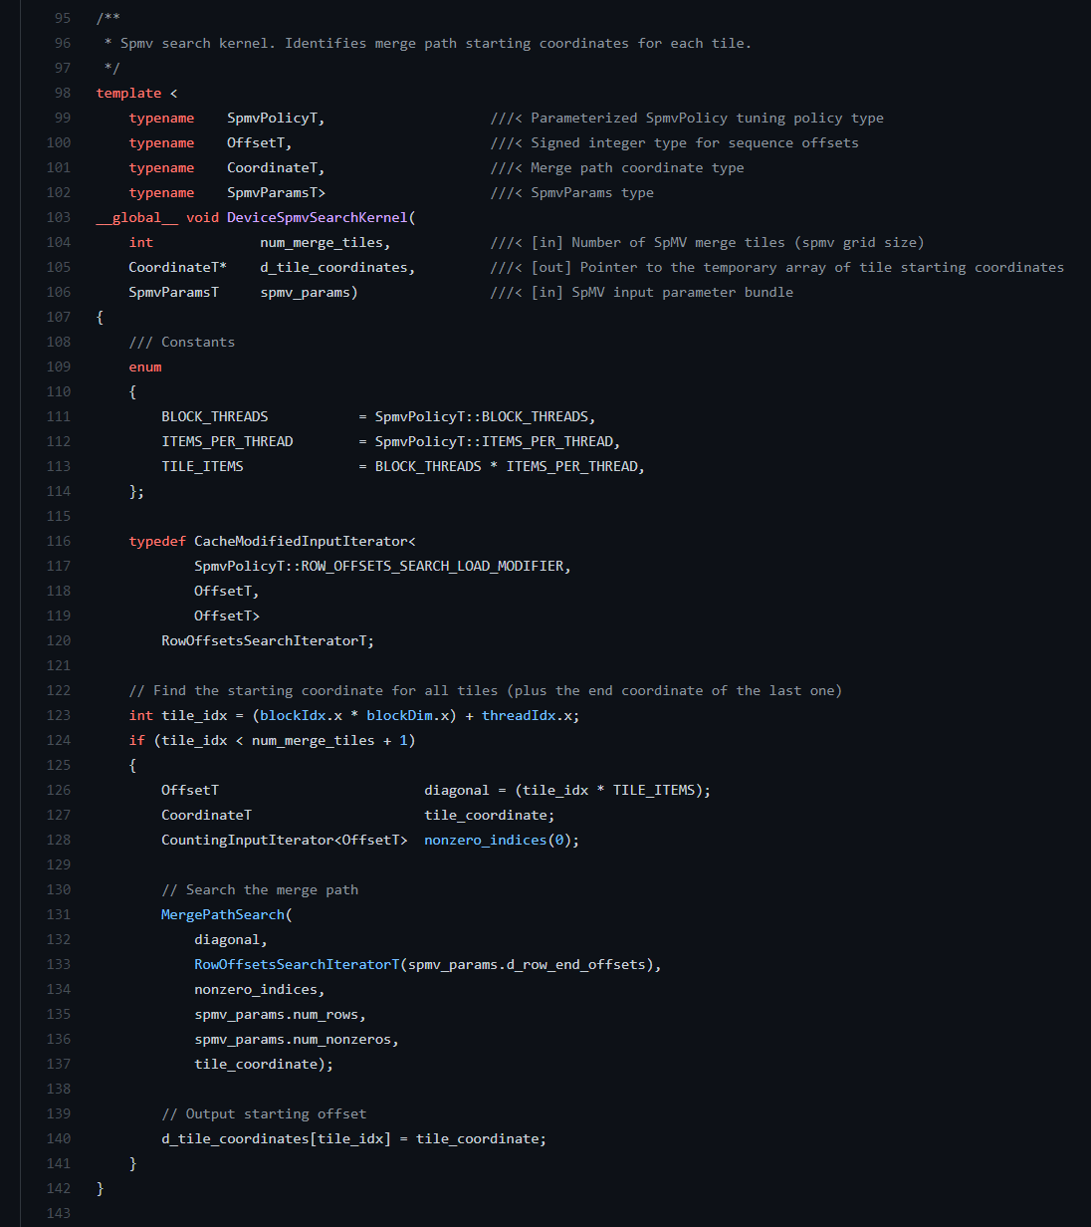
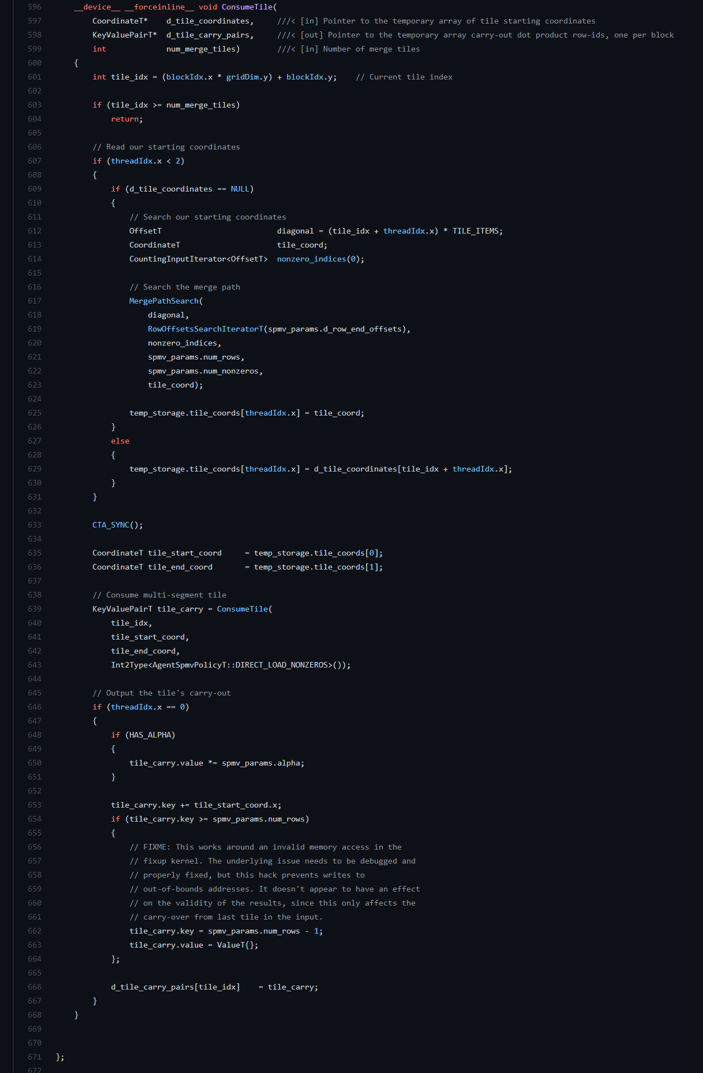
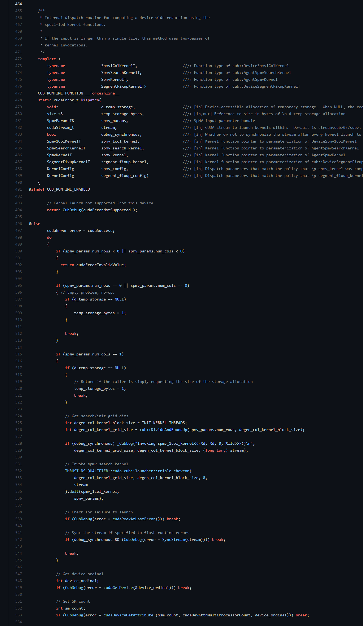
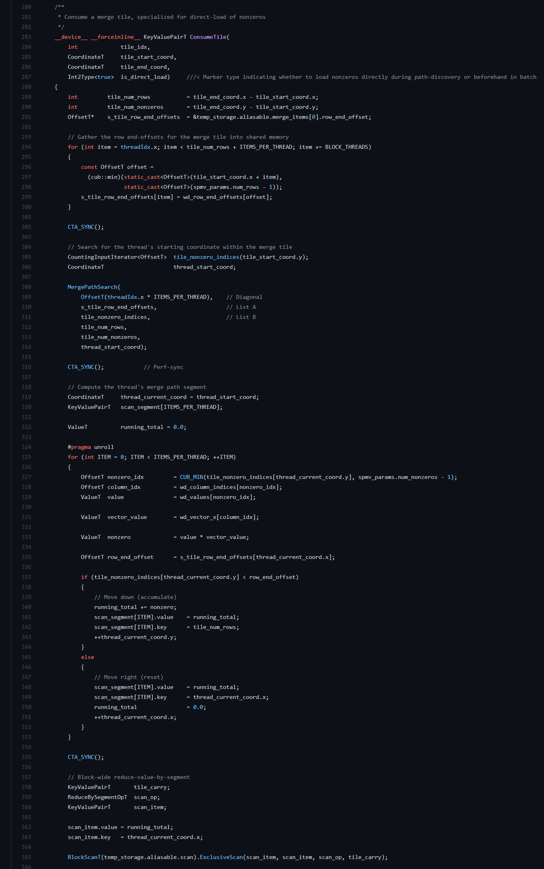
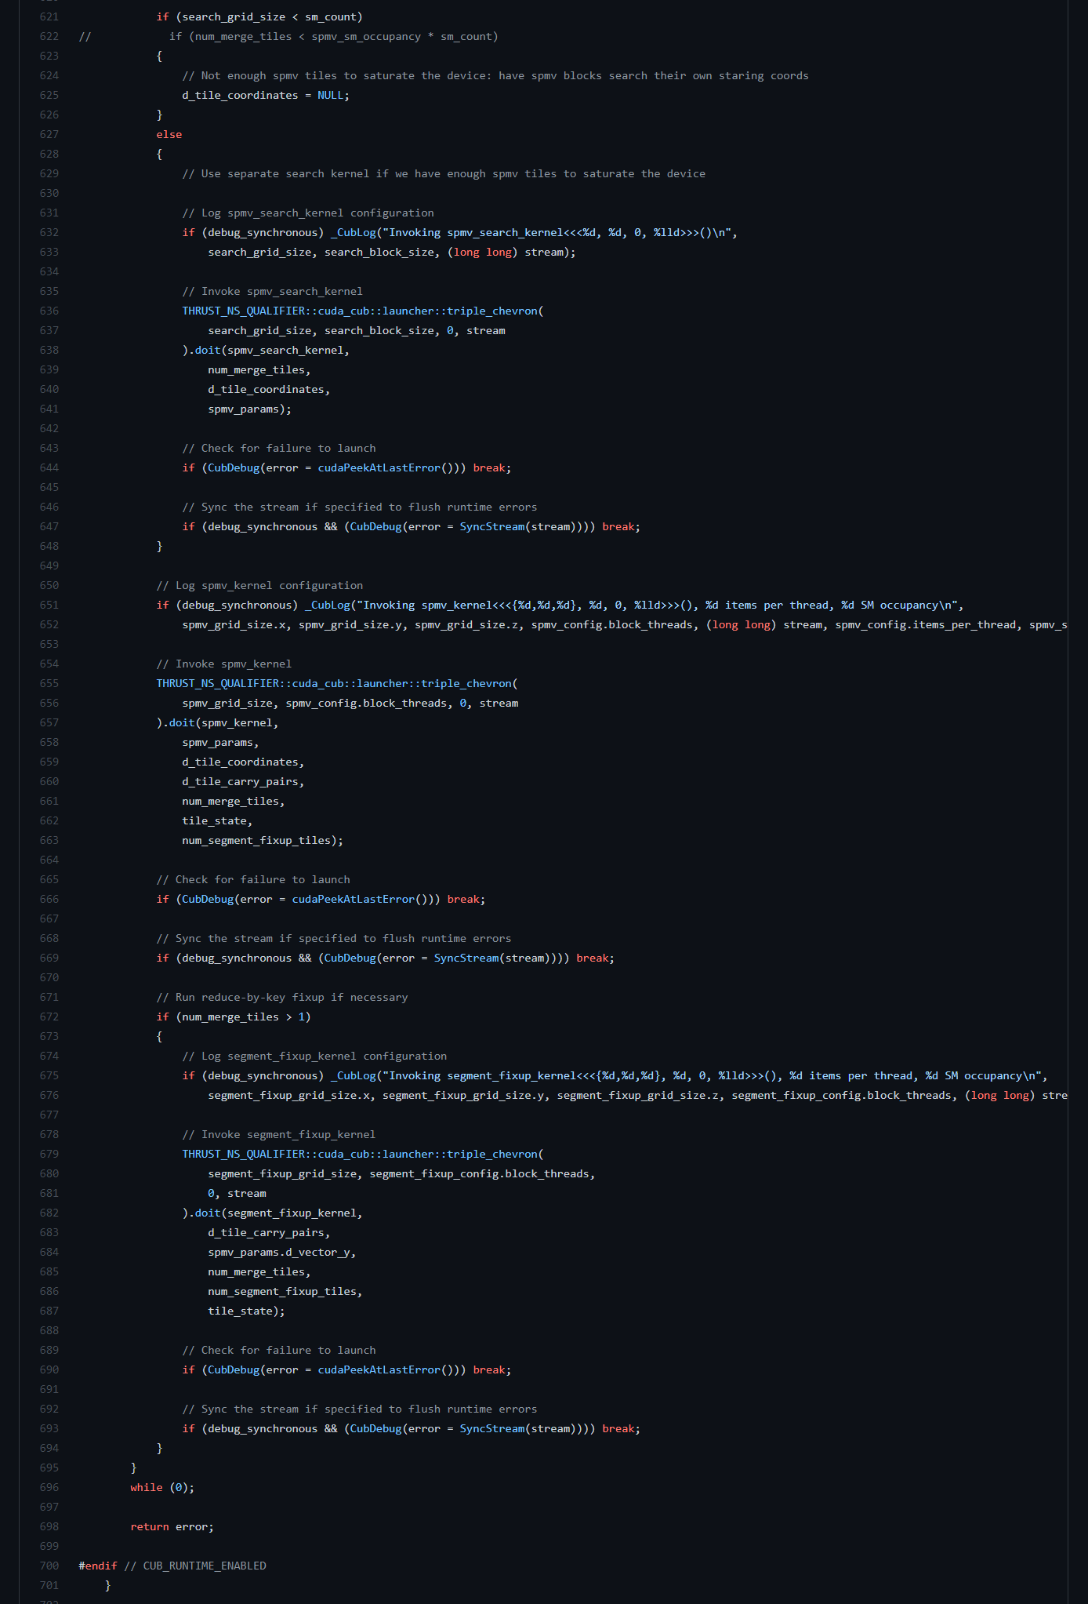
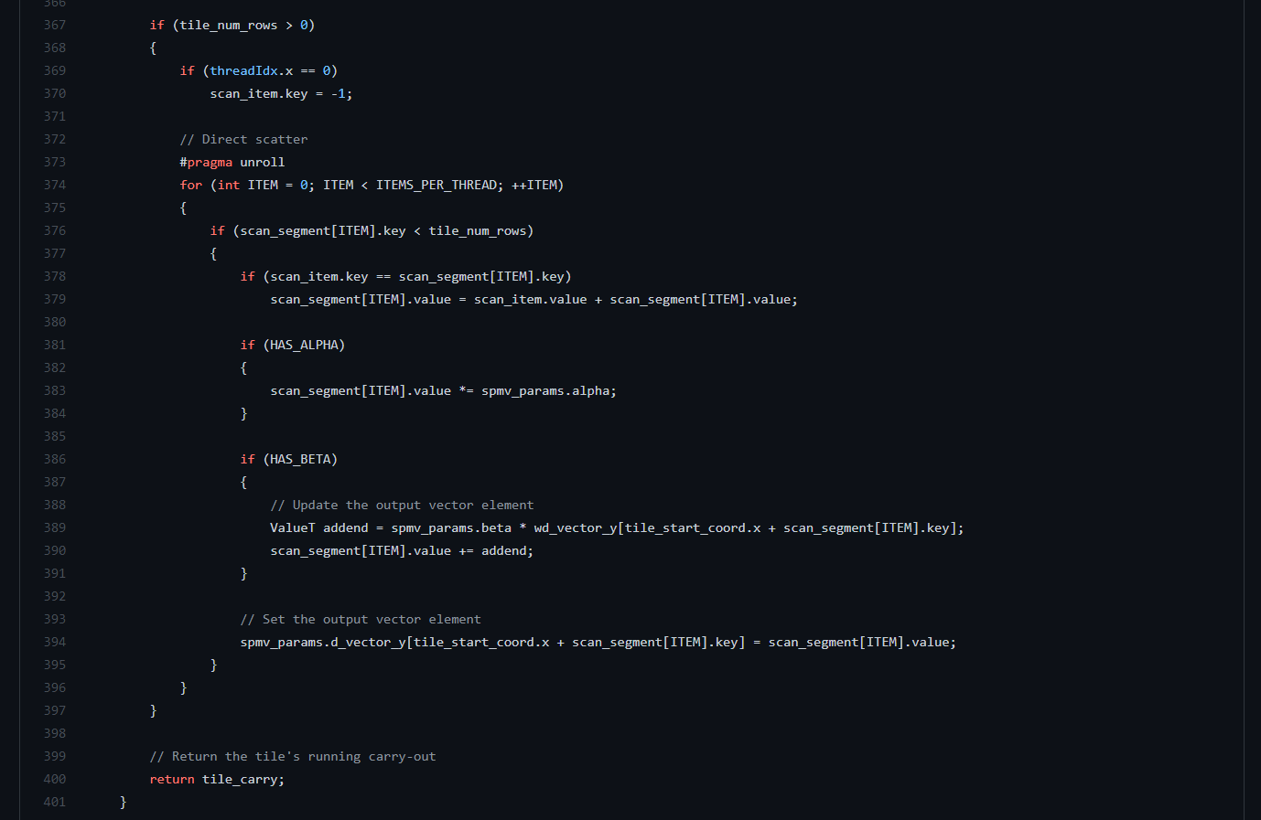
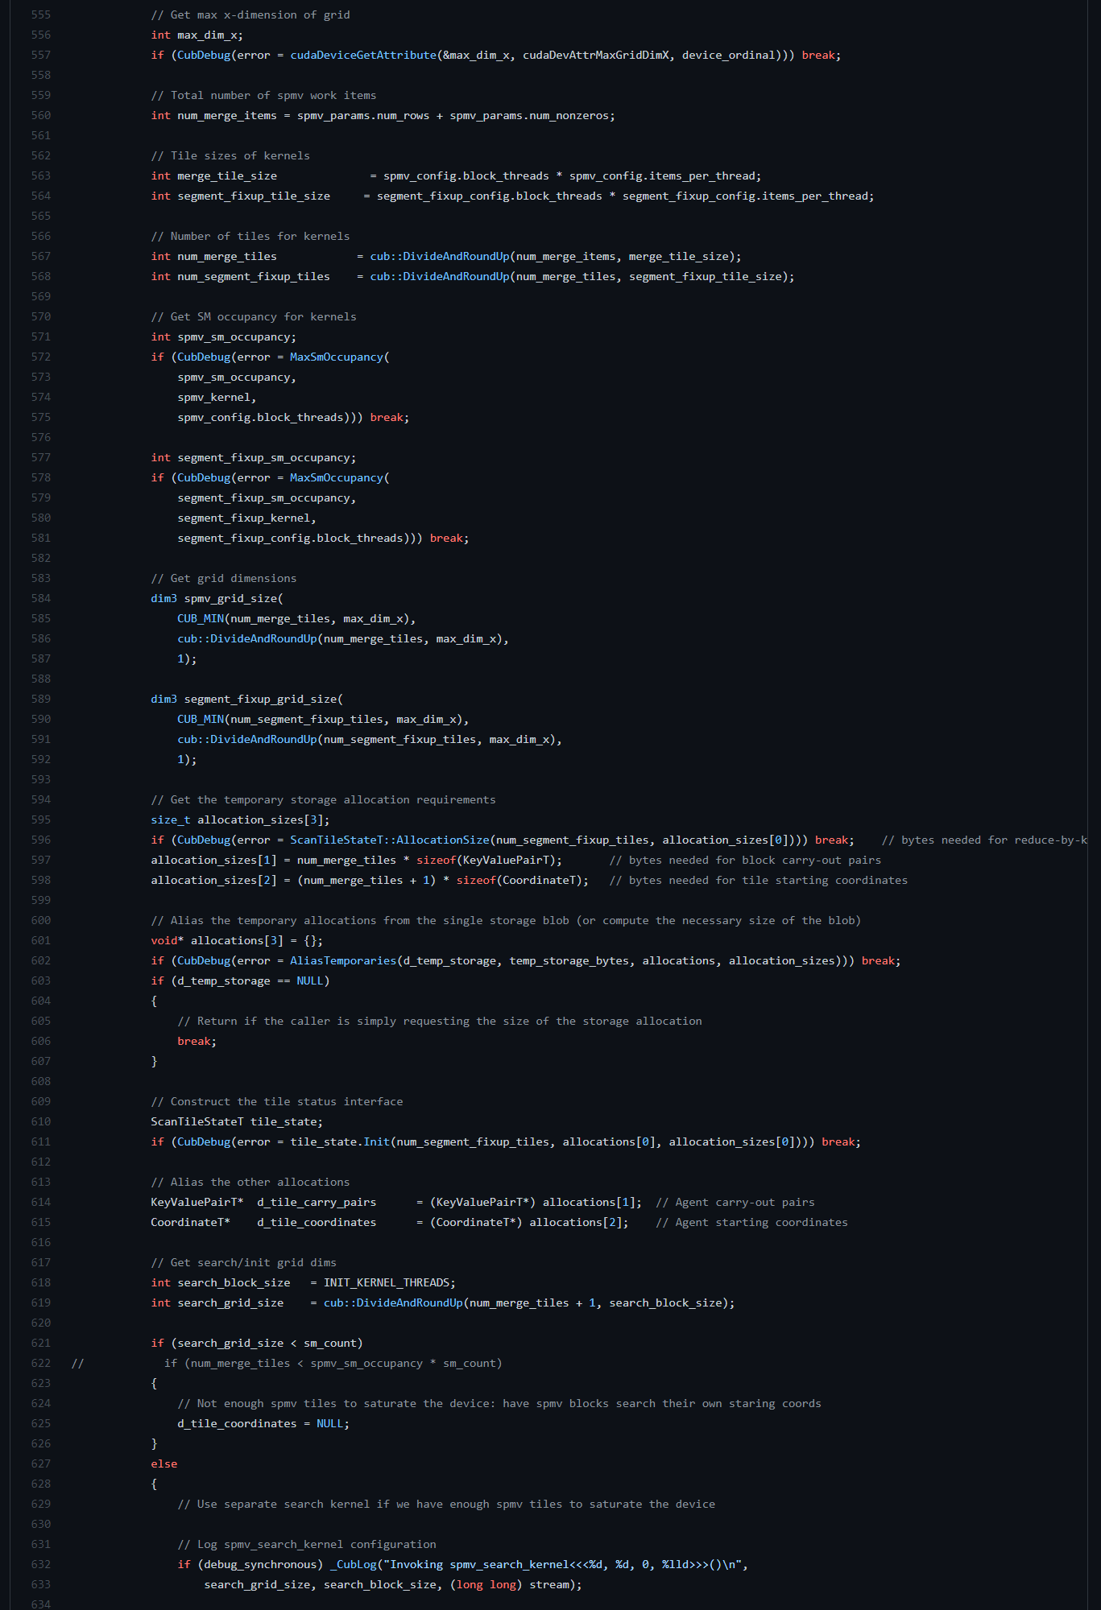
SpMV kernel + work-oriented load-balancing
Load-balance configurations and fix-up step
Notes:
Left side are the files that setup the kernel launch configurations and implement a fix-up step for SpMV, right side is the actual kernel that load-balances and performs y=Ax computation.
CUB uses merge-based (work-oriented) load-balancing (Merrill and Garland).
Notice the sheer amount of files and code required to implement a ninja-level load-balanced SpMV.

Slide 94
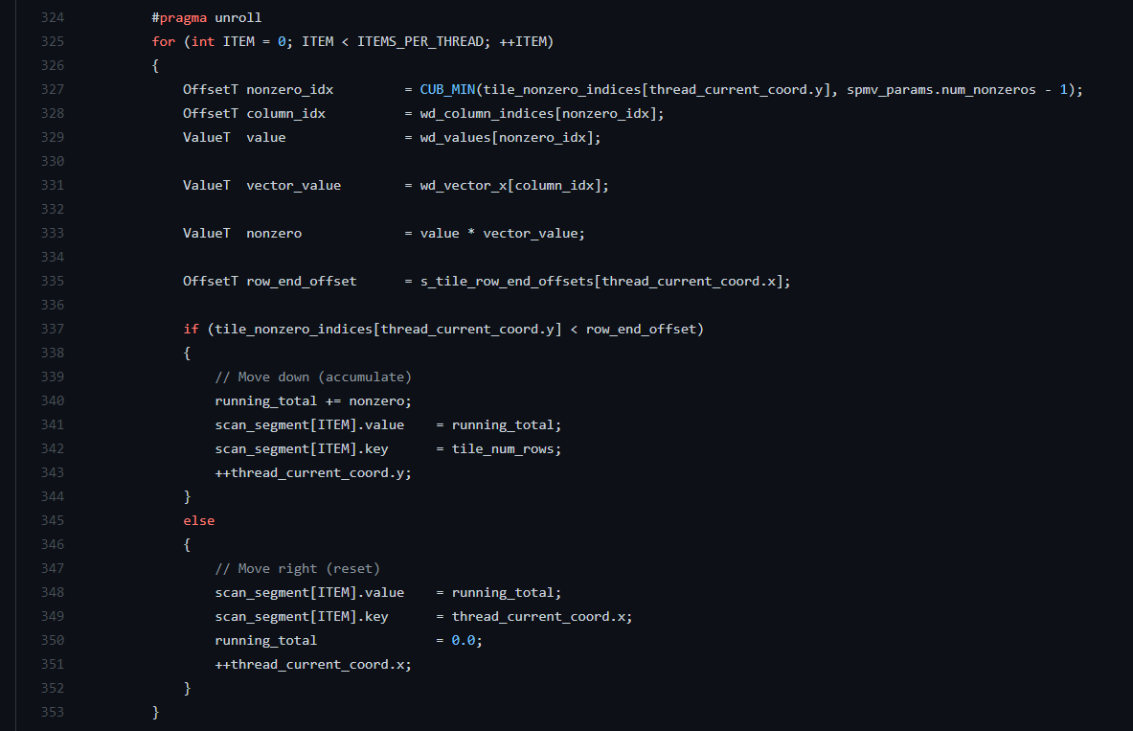
(1) GITHUB.COM/NVIDIA/CUB
Equates to the actual computation the user wants to do:
y = Ax
Notes:
The highlighted section is the actual computation that the user wants to do and cares about, which is y = Ax.

Slide 95
__global__ void spmv(const csr_t* A, const float *x, float *y) {
using namespace loops;
auto config = setup<schedule::merge_path>( A->offsets, A->rows, A->nnz);
float temp = 0.0f;
// loop over all assigned tiles for (auto m : tile::range(config)) {
// loop over all assigned atoms per tile for (auto k : atom::range(config))
temp += A->values[k] * x[A->indices[k]];
y[m] = temp;
temp = 0.0f;
}
}

Slide 96
__global__ void spmv(const csr_t* A, const float *x, float *y) {
using namespace loops;
auto config = setup<schedule::merge_path>( A->offsets, A->rows, A->nnz);
float temp = 0.0f;
// loop over all assigned tiles for (auto m : tile::range(config)) {
// loop over all assigned atoms per tile for (auto k : atom::range(config))
temp += A->values[k] * x[A->indices[k]];
y[m] = temp;
temp = 0.0f;
}
}

Slide 97
__global__ void spmv(const csr_t* A, const float *x, float *y) {
using namespace loops;
auto config = setup<schedule::merge_path>( A->offsets, A->rows, A->nnz);
float temp = 0.0f;
// loop over all assigned tiles for (auto m : tile::range(config)) {
// loop over all assigned atoms per tile for (auto k : atom::range(config))
temp += A->values[k] * x[A->indices[k]];
y[m] = temp;
temp = 0.0f;
}
}

Slide 98
// return the range of tiles to process
__device__ step_range_t<tile_size_t> tiles() const {
return loops::grid_stride_range(tile_size_t(0), tile_traits_t::size());
}
// return the range of atoms to process
__device__ auto atoms(const tile_size_t& tid) const {
return loops::range(tile_traits_t::begin()[tid],
tile_traits_t::begin()[tid + 1]);
}

Slide 99
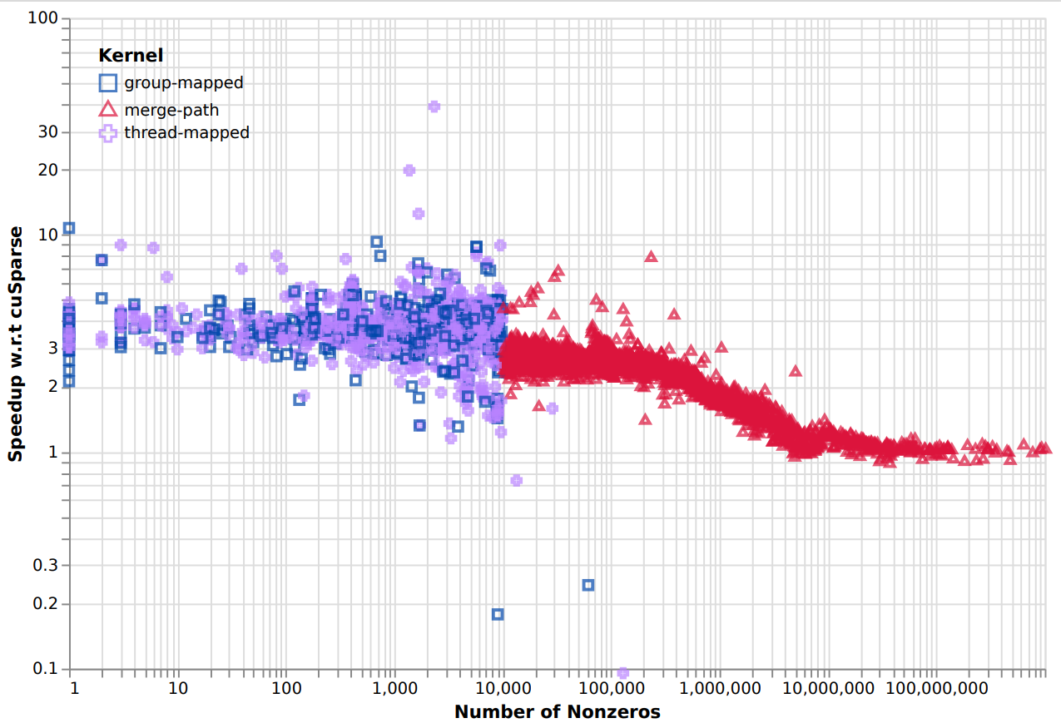
LOAD BALANCING ABSTRACTED: SPMV

Slide 100
Everything else.

Slide 101
Use thrust when you can.
You’ll be tempted to write your own “heterogeneous” array (CPU/GPU). Don’t.
CUDA error reporting is terrible. Good luck.
Spend a few days learning Nsight (System and Compute).
Don’t write your own binary search.
Use GitHub, Doxygen, GitHub actions (CI) and Googletests (Unit testing).

Slide 102
constexpr int N = 1<<20;
float* x; float* y;
cudaMalloc(&x, N * sizeof(float));
cudaMalloc(&y, N * sizeof(float));
cudaMemset(x, 1.0f, N * sizeof(float));
cudaMemset(y, 2.0f, N * sizeof(float));
constexpr int block_size = 128;
int grid_size = (N – block_size + 1) / block_size;
saxpy<<<grid_size, block_size>>>(N, 2.0f, x, y);
cudaFree(x); cudaFree(y);
You are going to forget to free the memory.

Slide 103
constexpr std::size_t N = 1<<20;
thrust::device_vector<float> x(N, 1.0f);
thrust::device_vector<float> y(N, 2.0f);
constexpr int block_size = 128;
int grid_size = 2 * SMs;
saxpy<<<grid_size, block_size>>>(N, 2.0f, x.data(), y.data());
Smart memory. No free required.

Slide 104
Use thrust when you can.
You’ll be tempted to write your own “heterogeneous” array (CPU/GPU). Don’t.
CUDA error reporting is terrible. Good luck.
Spend a few days learning Nsight (System and Compute).
Don’t write your own binary search.
Use GitHub, Doxygen, GitHub actions (CI) and Googletests (Unit testing).

Slide 105
Use thrust when you can.
You’ll be tempted to write your own “heterogeneous” array (CPU/GPU). Don’t.
CUDA error reporting is terrible. Good luck.
Spend a few days learning Nsight (System and Compute).
Don’t write your own binary search.
Use GitHub, Doxygen, GitHub actions (CI) and Googletests (Unit testing).

Slide 106
Use thrust when you can.
You’ll be tempted to write your own “heterogeneous” array (CPU/GPU). Don’t.
CUDA error reporting is terrible. Good luck.
Spend a few days learning Nsight (System and Compute).
Don’t write your own binary search.
Use GitHub, Doxygen, GitHub actions (CI) and Googletests (Unit testing).

Slide 107
Use thrust when you can.
You’ll be tempted to write your own “heterogeneous” array (CPU/GPU). Don’t.
CUDA error reporting is terrible. Good luck.
Spend a few days learning Nsight (System and Compute).
Don’t write your own binary search.
Use GitHub, Doxygen, GitHub actions (CI) and Googletests (Unit testing).

Slide 108
__device__ __host__
int binary_search(int* array, int x, int low, int high) {
while (low <= high) {
int mid = (low + high) / 2;
if (array[mid] == x)
return mid;
if (array[mid] < x)
low = mid + 1;
else
high = mid - 1;
}
return -1;
}

Slide 109
__device__ __host__
int binary_search(int* array, int x, int low, int high) {
while (low <= high) {
int mid = (low + high) / 2;
if (array[mid] == x)
return mid;
if (array[mid] < x)
low = mid + 1;
else
high = mid - 1;
}
return -1;
}

Slide 110
__device__ __host__
int binary_search(int* array, int x, int low, int high) {
while (low <= high) {
int mid = low + (high - low) / 2;
if (array[mid] == x)
return mid;
if (array[mid] < x)
low = mid + 1;
else
high = mid - 1;
}
return -1;
}

Slide 111
Use thrust when you can.
You’ll be tempted to write your own “heterogeneous” array (CPU/GPU). Don’t.
CUDA error reporting is terrible. Good luck.
Spend a few days learning Nsight (System and Compute).
Don’t write your own binary search.
Use GitHub, Doxygen, GitHub actions (CI) and Googletests (Unit testing).

Slide 112
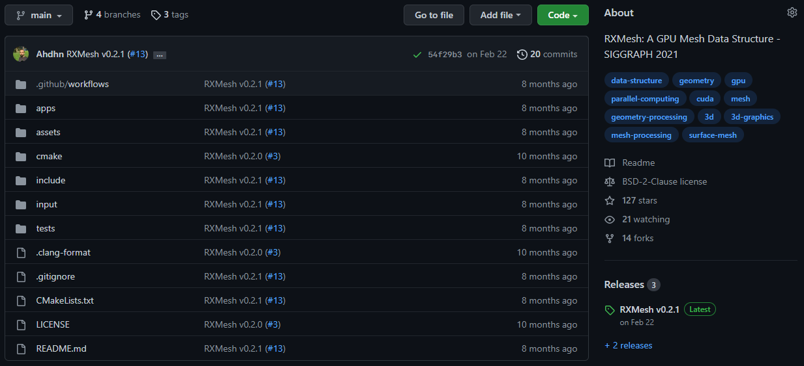
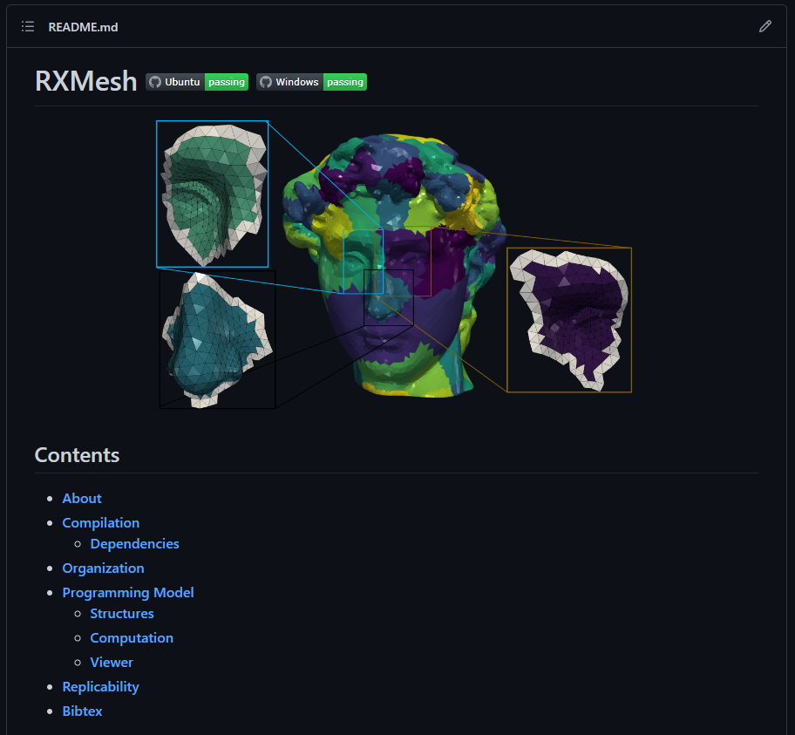

Slide 113
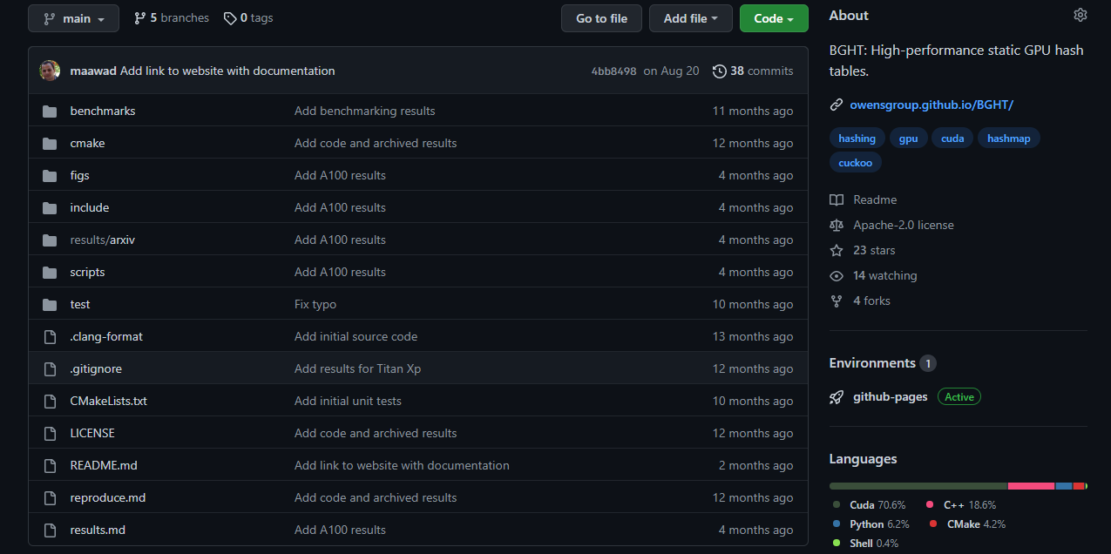


Slide 114
https://github.com/neoblizz/neoblizz/wiki

Slide 115
CUDA 301.
Solve Multi-GPUs and Multi-Node.

Slide 116
CUDA 301.
Solve Multi-GPUs and Multi-Node.
You got this.

Slide 117
THANK YOU ALL!
John D. Owens
Serban D. Porumbescu
Jason Lowe-Power, Soheil Ghiasi, Venkatesh Akella
Stephen Jones, Michael Garland, Duane Merrill, Cris Cecka
Sean Treichler, Aamer Jaleel
Owensgroup lab students!

